Slide 1

POKEDEX
MISAEL BOLAINEZ - LAB 2L
ROHIT VEMURI - LAB 3L
https://github.com/missile720/CSE111Project

Slide 2
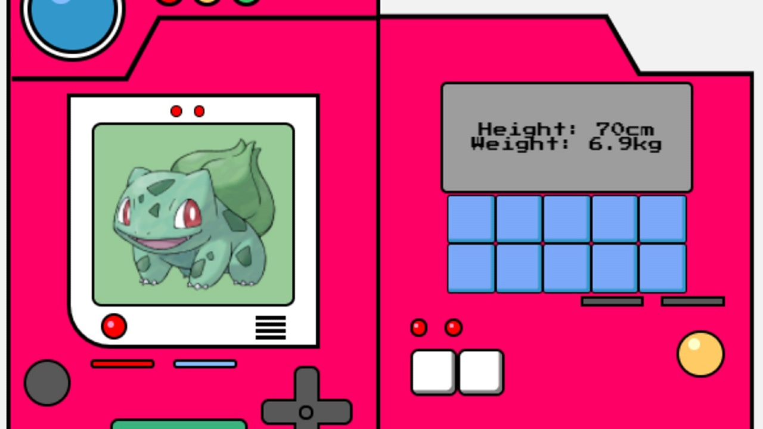
SYSTEM DESCRIPTION
Our project is a recreation of the pokedex. The Pokedex in Pokemon is a database that holds information about each Pokemon.
The user can search for pokemon via various different factors:
ability, name, moves, types, etc.
The user can also check movesets pokemon can learn and the method it can learn it by

Slide 3



IMPLEMENTATION
Languages used: HTML, Python (Flask), CSS, and SQL, SQLite
Flask, SQLAlchemy used for Front-End portion of the webpage, easy for development
SQL, SQLite used for the Back-End portion of the webpage, using SQL for the database of the Pokedex
Flask used due to the dynamics of the webpage, also really easy to connect to HTML, CSS

Slide 4
USE CASE DESCRIPTION
The user can input the name of the pokemon, national number, move, type of the pokemon, or ability to see the specific pokemon(s) that apply
The user can search moves with specific pokemon Egg Group
The user can search ability with minimum attack and total stats
It will display data on the pokemon depending on which search method is implemented
If more than one pokemon applies then the results will display a list of those pokemon
The user can also click on a pokemon, the results will display the info of that pokemon, their ability, type, and what moves they can learn in the form of tables

Slide 5
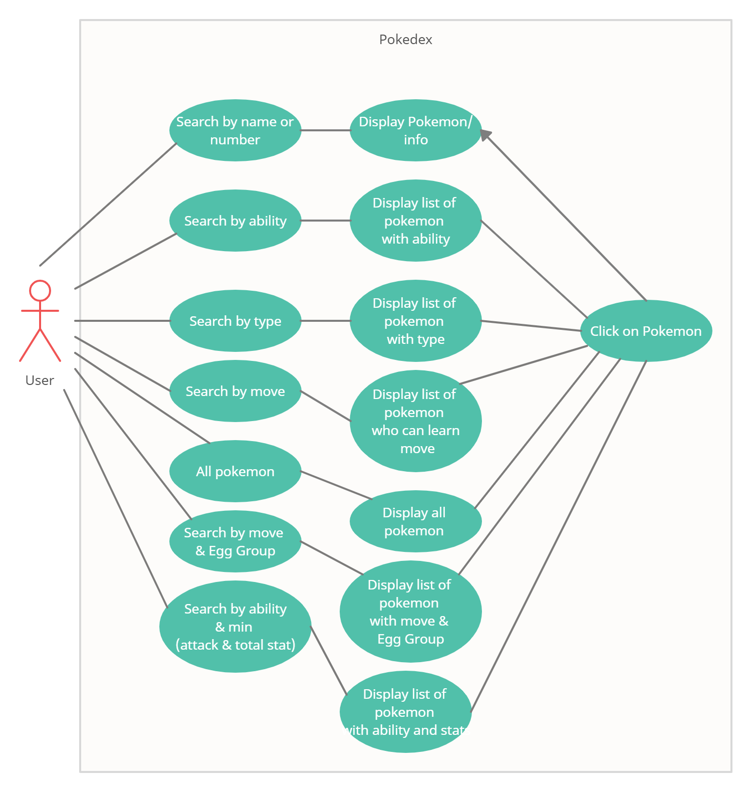
USE CASE DIAGRAM

Slide 6
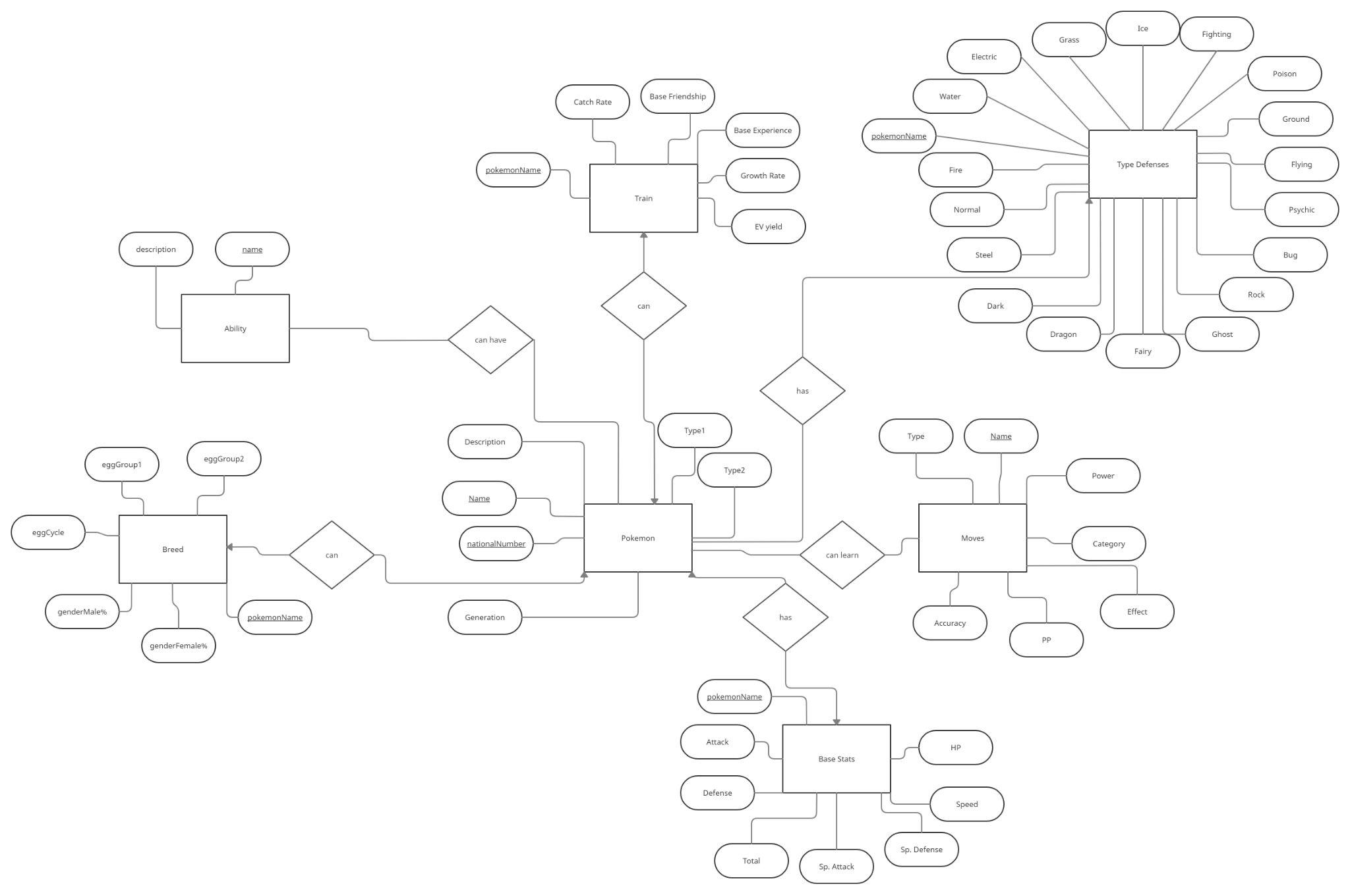
E/R DIAGRAM

Slide 7
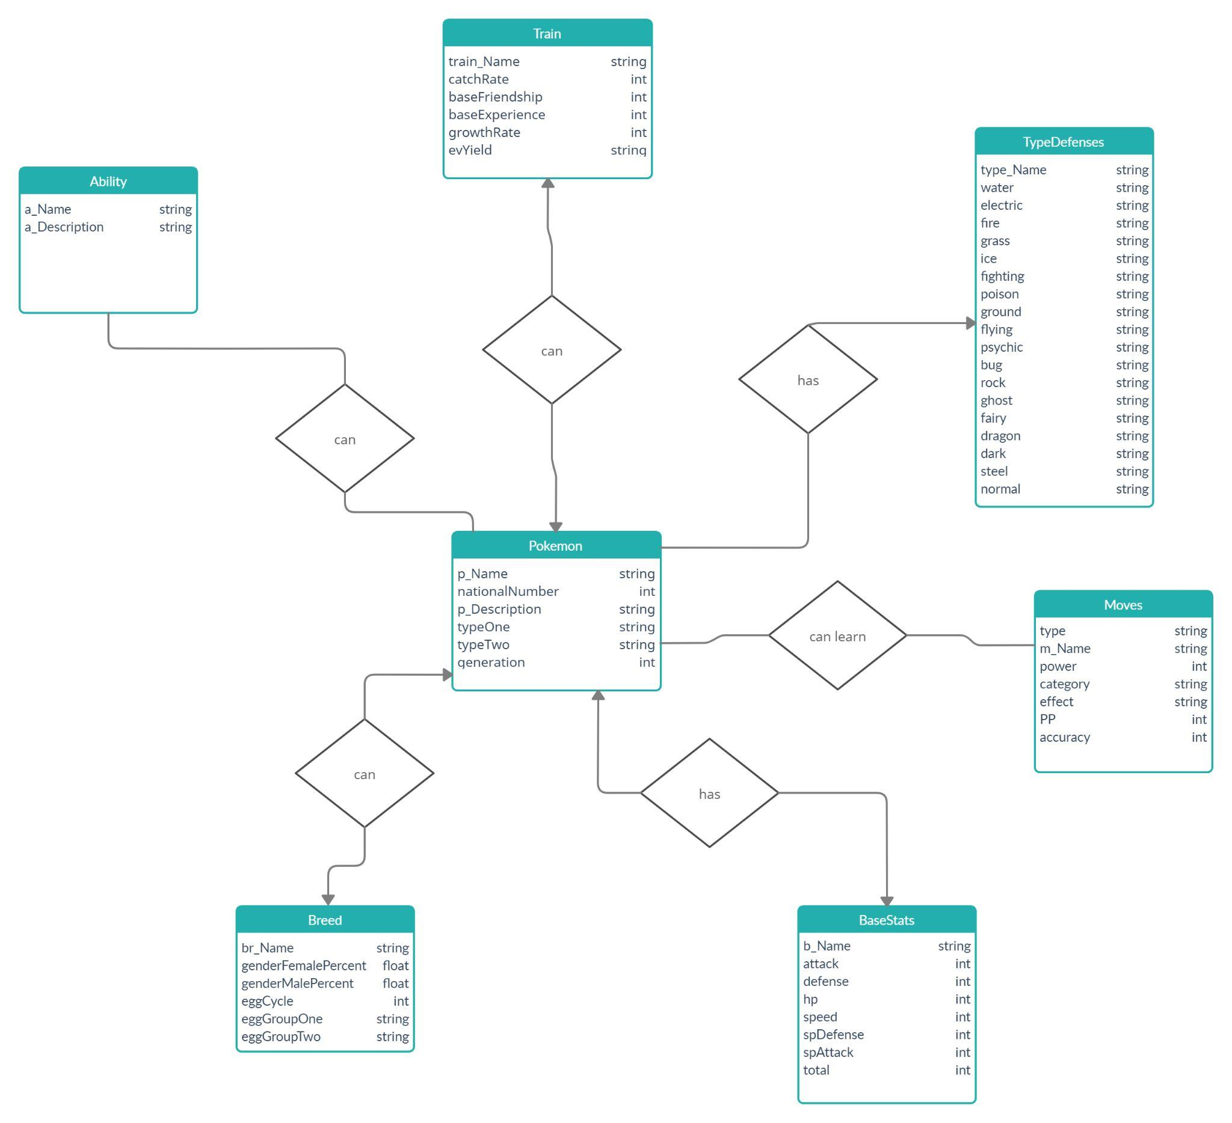
RELATIONAL SCHEMA

Slide 8
Demo

Slide 9
Thanks!
Q&A

